Slide 1

YOLOCODE
Miken Melvin(Front End Developer)
Tuncer Schmidt(BackEnd Developer)

Slide 2

Updated Vision
YOLOCODE website will be a great innovation for anyone WHO wants to be a part of the computer science world WHO are willing to ask for help and get active.

Slide 3
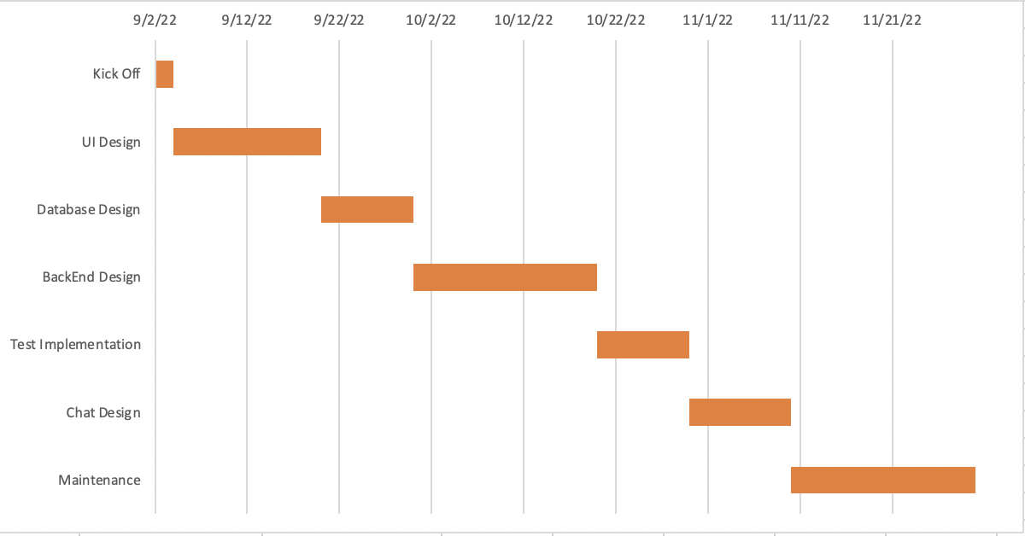
TimeLine

Slide 4
Languages and Frameworks
Javascript
Html
Css
Express
Nodejs
Yarn
Firebase

Slide 5
Tasks
Project Kick Off
UI Design : Login and Sign up pages were completed
Accurate timing for project
Everything on progress
Firebase was added instead of Mongodb

Slide 6
Details of Task
Sign Up and Login Pages were created
While creating these two pages, firebase authentication method was used.
Firebase Auth was added to our projects and code will be shown during presentation.
In addition to that react frameworks were added to project
Many different imports are done especially react side e.g redux, component, styled-components etc.
Necessary photos were added as background image but can be changed.
Click functions were added to projects. Authentication method is still not decided but most probably it will be email and password and then necessary implementations will be done for authentication
Necessary css and html specifications were included but we will make it more professional
Miken and Tuncer prepared UI design together

Slide 7
References
React Redux
Bootstrap
Firebase
React-component
React-redux

